Slide 1
Dallas crime time series analysis
DS6373 – Time Series
David Wei

Slide 2


introduction
Summary:
The purpose of this time-series analysis will be to evaluate crime over time in Dallas and study its patterns, and the types of victims that are most effected by it. We will also use our findings to forecast short- and long-term horizons to see what crime will be like in the coming future.
Data Description:
The data captures all crimes reported to the DPD department between 2002 up to the current date and contains almost 1000+ unique types of crimes ranging from misdemeanors to manslaughter.
For the purpose of our study, all crime types are included.
Source:
The dataset represents the Dallas Police Public Data from their RMS (records management system) and provided openly via Dallas OpenData.
Dallas OpenData: https://www.dallasopendata.com/
Police Incidents Data: https://www.dallasopendata.com/Public-Safety/Police-Incidents/qv6i-rri7

Slide 3
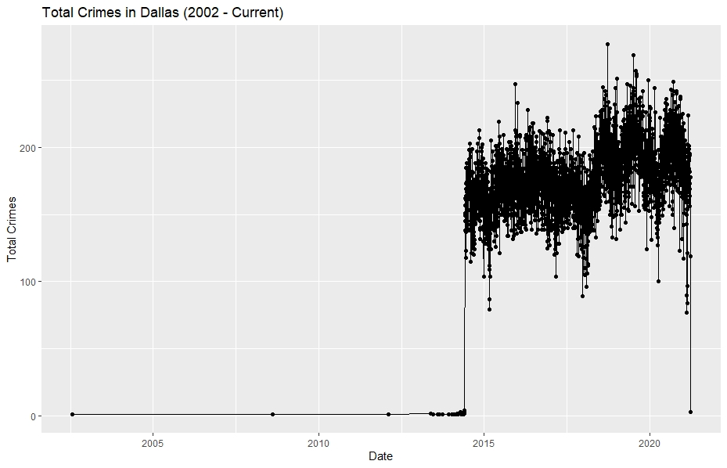
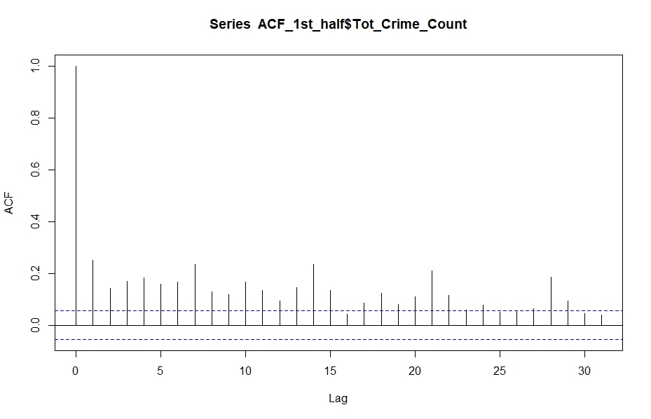
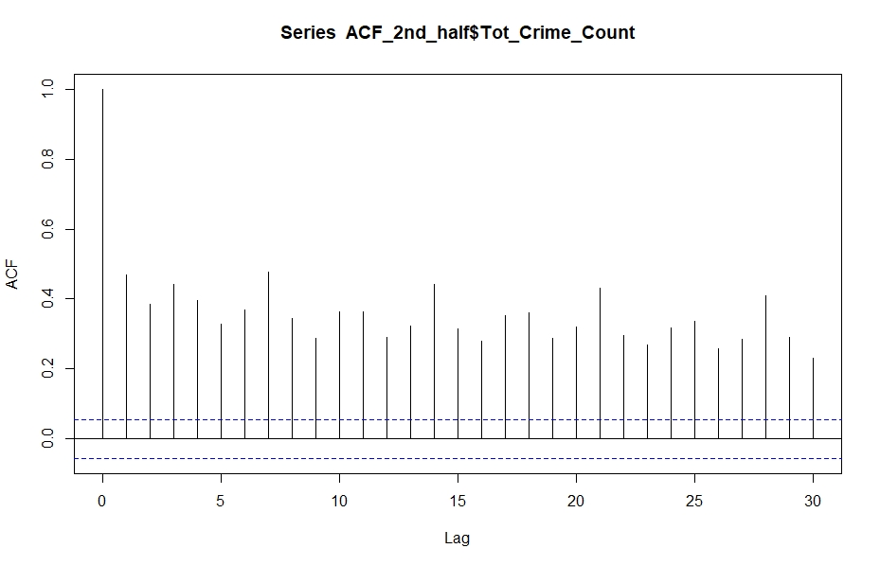
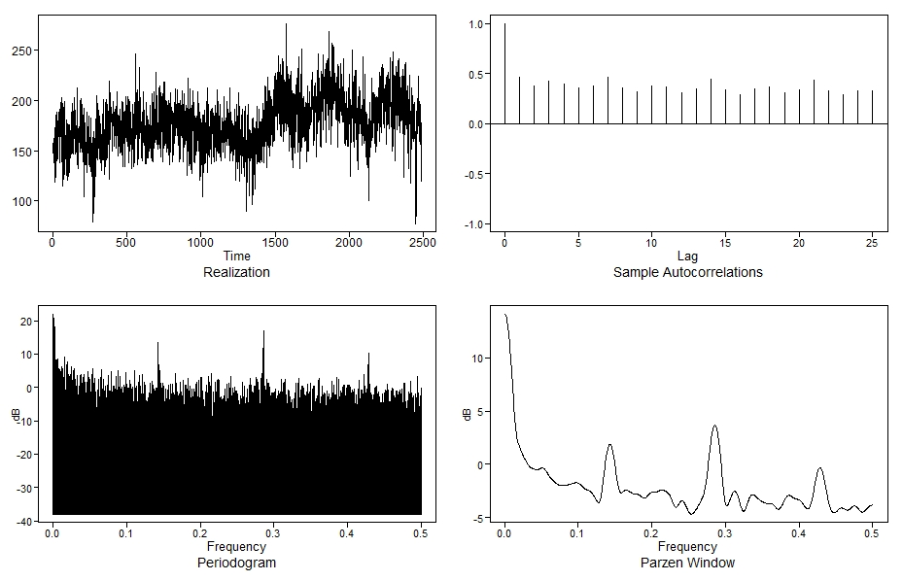
Data summary
Original Data
Pre-processing & Tidying:
Original data was case-by-case incidents (758,904 records), so data was aggregated on all attributes and transformed into daily day-by-day basis (2531 records).
Most data prior to 2015 had to be removed
Stationarity Assumptions:
1. Mean: Crime itself can be argued to be stationary since it is not dependent on time itself but rather other conditions of society that effect it.
2. Variance: The variance of crime is Dallas non-stationary given how some slices of time have a larger variance than others.
3. Correlation: Nonstationary correlation structures based on ACFs below:
Realization Metrics:
ACF: Slowly dampening ACFs with positive oscillating autocorrelations and evidence of wandering behavior.
Spectral Density: Strong evidence of wandering behavior as shown by the frequency peak at 0. Weak but possible evidence of seasonality given the cyclic subsequent peaks at .13, .28 and .43
Cleaned Data

Slide 4
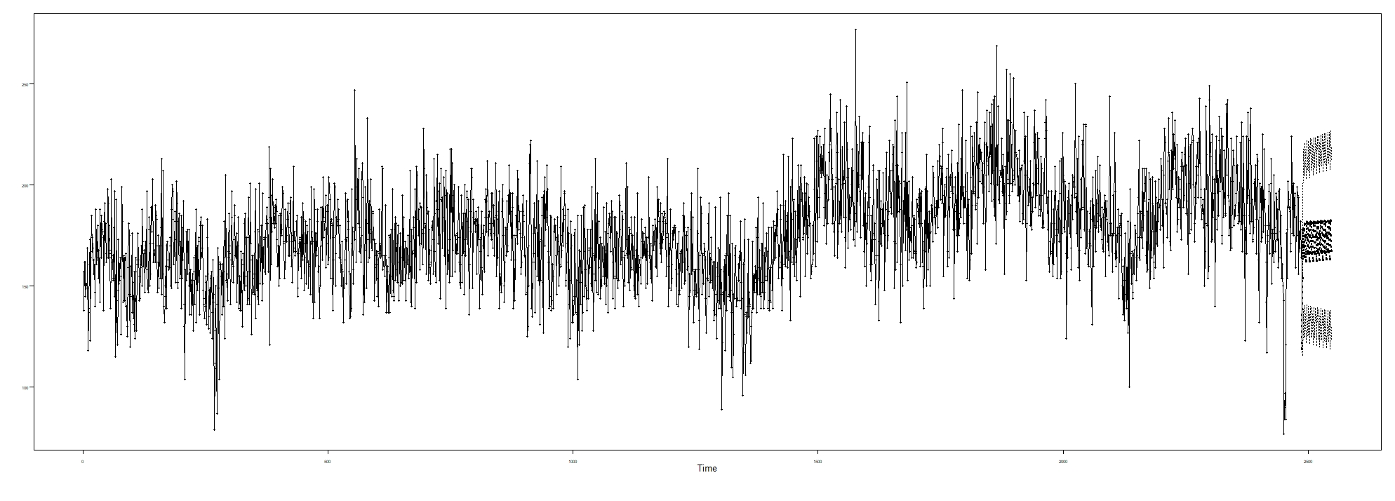
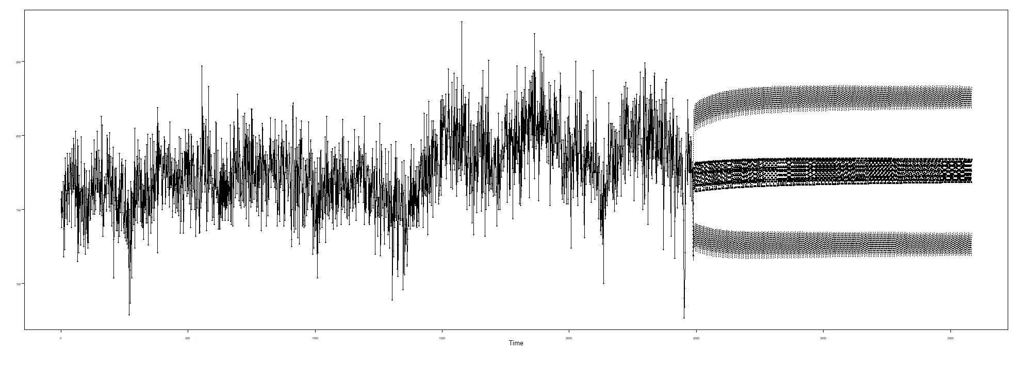
Modeling - ARMA(5,5)
Stationary ARMA(5,5) Model:
$\left(1−.99B)(1−.29B−.09B^{2}−.57B^{3}−.54B^{4}+.51B^{5})\right)\left(X_{t}+176\right)={(1−.09B−.03B^{2}−.5B^{3}−.61B^{4}+.38B^{5})a}_{t}$ , ${\hat{σ}}_{a}^{2}=$ 387.8
60-Days Short Term Forecast
Model Type | Short ASE | Short Rolling ASE
ARMA(5,5) | 852.4636 | 473.4389
3-Years Long Term Forecast
Model Type | Long ASE | Long Rolling ASE
ARMA(5,5) | 777.2503 | 897.8244

Slide 5
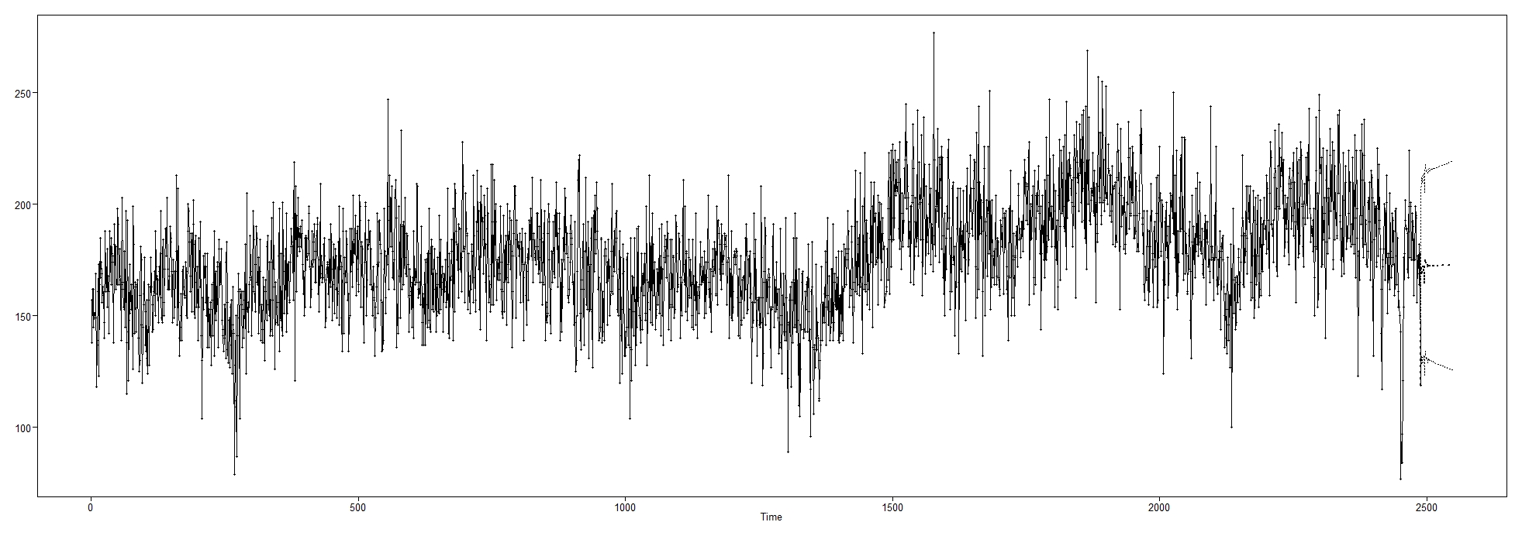
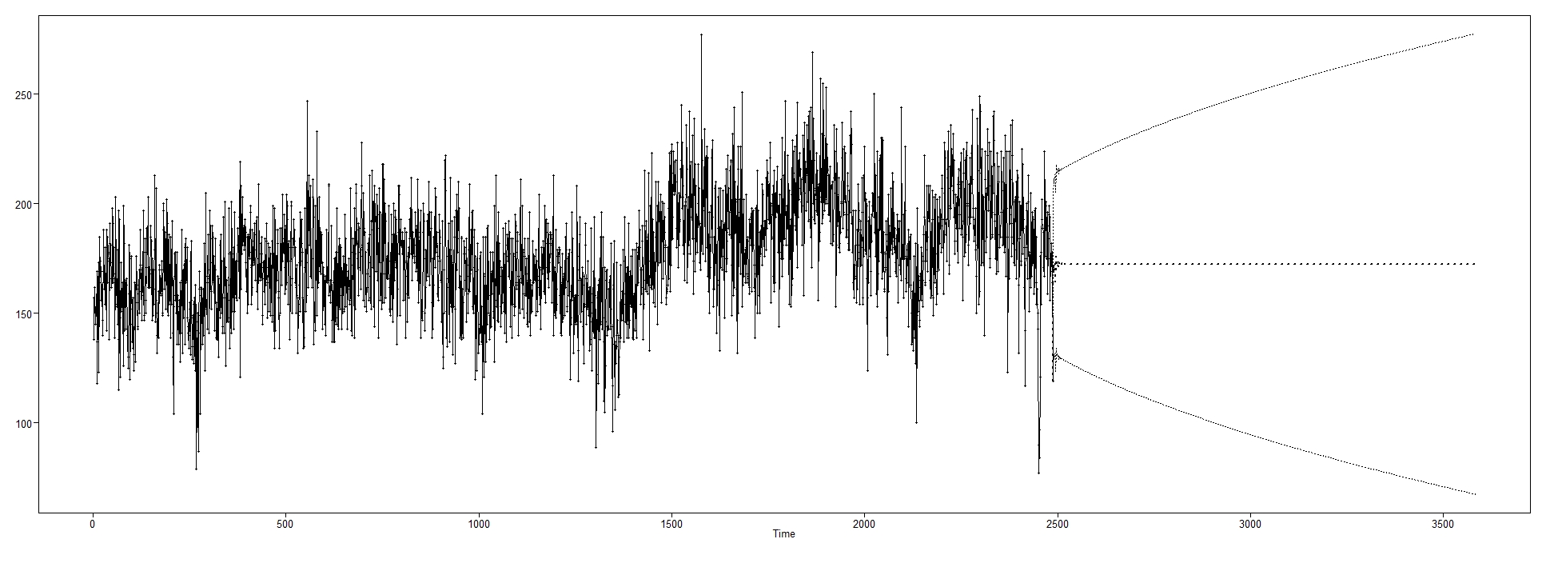
Modeling – ARIMA(9,1,1)
Non-Stationary ARIMA(9,1,1) Model:
$\left(1−B)(1−.14B+.002B^{2}−.07B^{3}−.02B^{4}+.03B^{5}−.005B^{6}−{.15B}^{7}+.{04B}^{8}+.06B^{9})\right)\left(X_{t}+176\right)={(1−.94B)a}_{t}$ , ${\hat{σ}}_{a}^{2}=$ 393.86
60-Days Short Term Forecast
Model Type | Short ASE | Short Rolling ASE
ARMA(5,5) | 852.4636 | 473.4389
ARIMA(9,1,1) | 888.2925 | 518.2834
3-Years Long Term Forecast
Model Type | Long ASE | Long Rolling ASE
ARMA(5,5) | 777.2503 | 897.8244
ARIMA(9,1,1) | 866.2923 | 1304.745

Slide 6
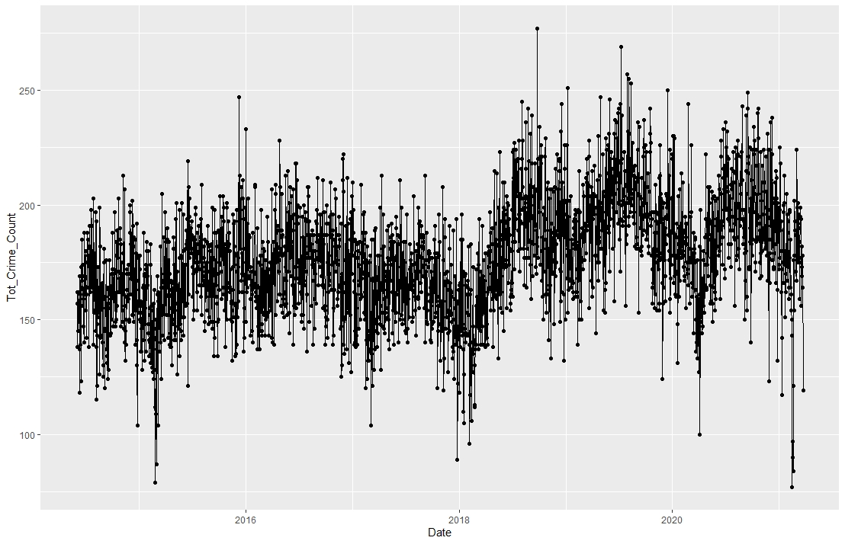
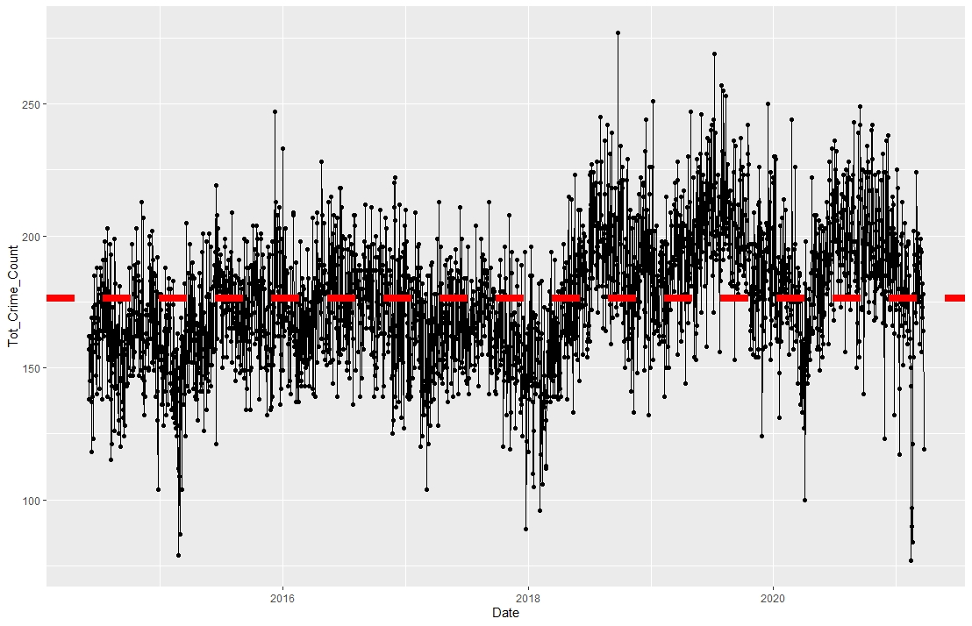
Modeling – Signal-plus noise
Is crime going up?
Is crime constant in Dallas?
???

Slide 7


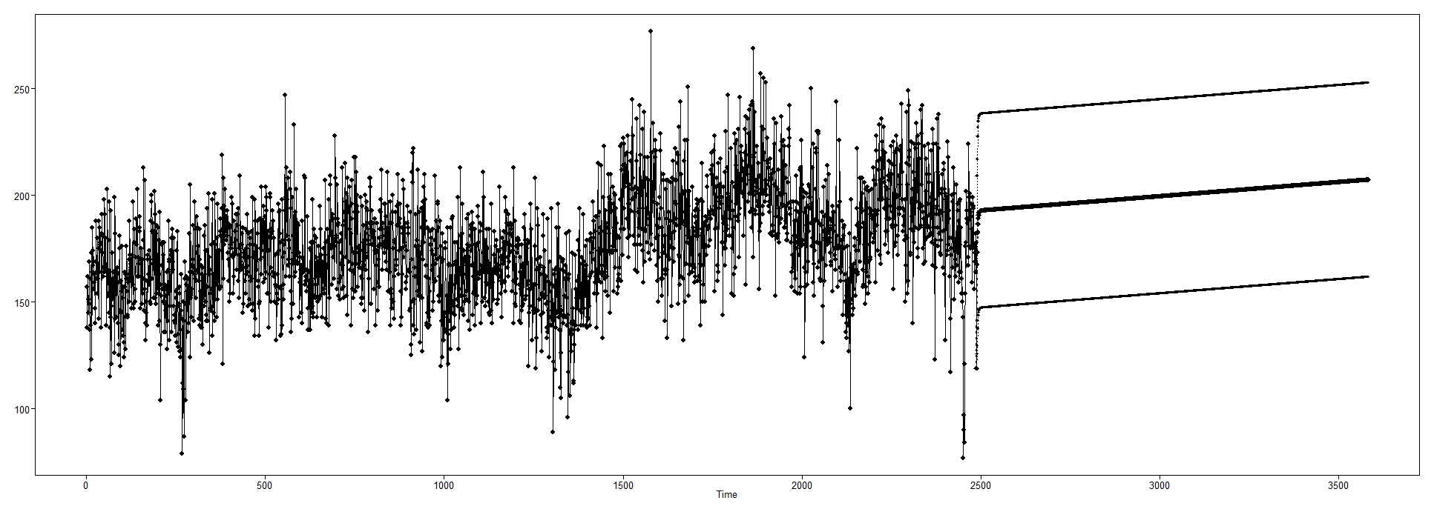
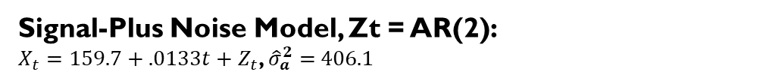
Modeling – Signal-plus noise
Signal-Plus Noise Model, Zt = AR(2):
$X_{t}=159.7+.0133t+Z_{t}$, ${\hat{σ}}_{a}^{2}=$ 406.1
60-Days Short Term Forecast
Model Type | Short ASE
ARMA(5,5) | 852.4636
ARIMA(9,1,1) | 888.2925
Sig-Plus Noise | 1339.791
There is a trend, but it is not significantly different from 0 (no trend). In fact, using the rate of crime growth, we estimate that general crime increases at a rate of 1.84% per year… that’s less than 2% a year in the city of Dallas!
3-Years Long Term Forecast
Model Type | Long ASE
ARMA(5,5) | 777.2503
ARIMA(9,1,1) | 866.2923
Sig-Plus Noise | 731.63

Slide 8
Conclusions + next steps
So far we can conclude… “all models are wrong, some are useful”.
Model Type | Short ASE | Short Rolling ASE | Long ASE | Long Rolling ASE
ARMA(5,5) | 852.4636 | 473.4389 | 777.2503 | 897.8244
ARIMA(9,1,1) | 888.2925 | 518.2834 | 866.2923 | 1304.745
Sig-Plus Noise | 1339.791 | -- | 731.63 | --
Better for short term forecasting
Better for long term forecasting
Next Steps & Future Areas of Analysis:
Vector Autoregressive (AR) with Victim Sex and Victim Race
Neural Network Model
Ensemble Method

